Slide 1
WELCOME!
Mrs. Bartell
cbartell@rcsdk8.org
771 – 1750
Follow @BartellTeach @BartellsDojo

Slide 2
Introduction
*27th year of teaching
*RSP, SDC, and 2 - 4th grade general education classes

Slide 3
Classroom Management
Be safe, responsible, respectful, and kind- Please read Bartell’s Classroom Management Plan and review it with your child.
“A child may often forget what you say, but they will always remember how you make them feel.” Maya Angelou

Slide 4
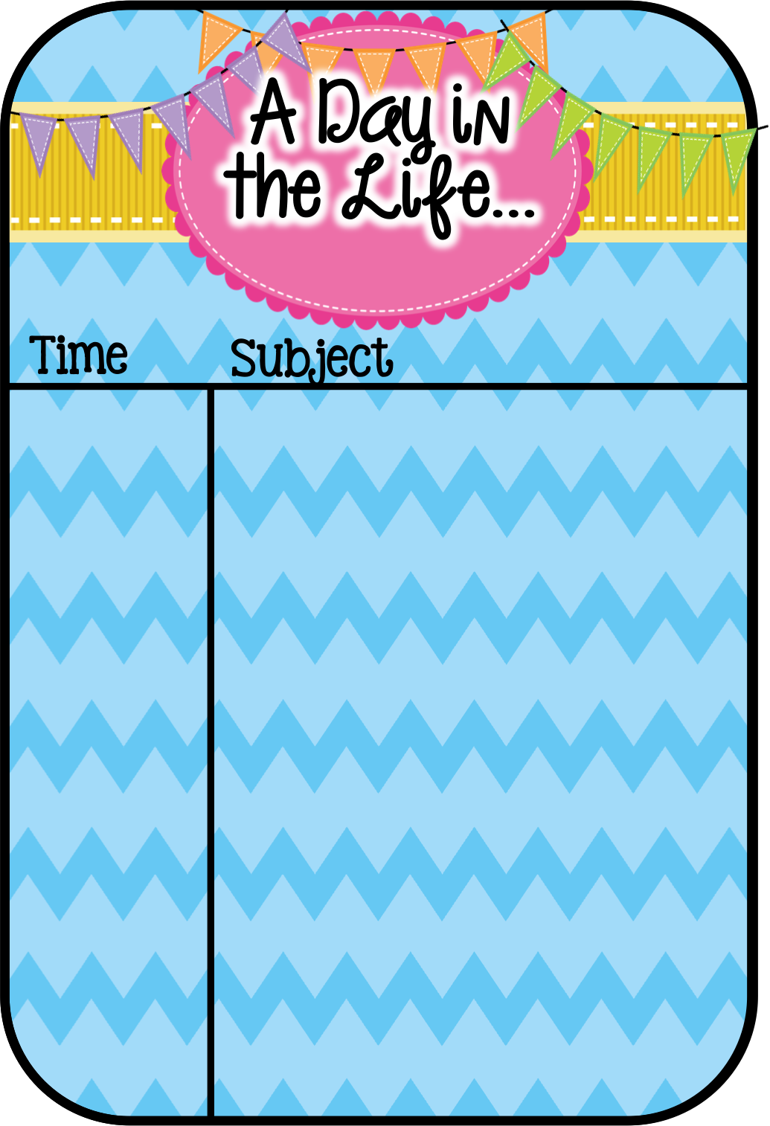
Tentative Daily Schedule
8:30 – 10:47 math
10:47 - 11:00 snack recess
11:00 - 12:05 Writers Workshop/ELA (English Language Arts)
12:05 - 12:50 lunch
12:50 - 2:10 ELA (English Language Arts)
2:10 - 2:11 afternoon recess
2:11 - 2:41 designated ELD (English Language Development)
2:41 - 3:00 science or social studies
PE M 1:10 & W 9:05 + Buddy Run
Library M 10:25
Music TH 9:20
Dismissal at 1:50 every Monday for Professional Learning Communities

Slide 5
Homework
Research had been unable to prove that homework improves student performance. This year homework will only consist of work that your student did not finish during the school day. There will be no formally assigned homework this year, unless as a class we decide on a “project”. If you choose to have your child do the Homework and Remembering pages for math, you may. However, I will never correct these and do not want them turned in.
I do ask that you spend your evenings doing things that are proven to correlate with student success. Reading has more impact on your child’s achievement than any other activity at school. This year, the children will each have a 40 book requirement. Daily reading is what transforms reading into a lifelong habit and builds reading ability.

Slide 6
Common Core Standards
The third grade California state standards show what skills and concepts students are expected to know in each subject area. Some standards will be taught all year, while others will be covered in specific trimesters. We’re teaching students to justify their thinking verbally and in writing and requiring them to cite evidence from the text.

Slide 7
Helping to Support Our Class Needs
As an educator, I want to make sure my students have the materials they need to succeed, so I generally have several Donors Choose classroom requests throughout the school year.
Amazon wish list for @BartellsDojo link is here: http://a.co/0FIOkQ9

Slide 8
Friday Folders
These come home every Friday and are due signed by Monday. Unsigned folders will not be accepted.
The data binder, which will be used throughout the year and come home frequently on Fridays, is an opportunity for your child to share his accomplishments. Please look through the binder with your child the night it comes home and discuss the papers and data, sign and date the paper located in the front of the binder, and have your child return it promptly. I cannot add new data or work samples if the binder is not returned. In addition, your child uses this binder daily to log his reading progress.

Slide 9
You Say It’s Your Birthday!
In order to help guide our students to healthy eating habits our school will be following District guidelines for classroom treats for birthday celebrations.
Absolutely NO cupcakes, cookies, or sweets.
Healthy options: fruit, string cheese, GoGurt, pencil, eraser. I prefer you send a copy of your child’s favorite book to donate to our class library.

Slide 10
Scholastic Book Orders
I will be sending home the Scholastic Reading Club order forms periodically in the Friday folder. If you haven’t ordered from Scholastic before, please consider doing so this year. Their prices are reasonable and the quality is excellent. You never pay sales tax, and you don’t even pay shipping and handling. All orders are shipped directly to our classroom. When you order from Scholastic you are directly supporting our classroom because we get bonus points from every order that we can use to buy books for the class!

Slide 11
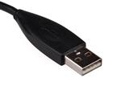
Technology Request
To keep your children healthy while using Chromebooks, please have your child bring in his own earbuds as soon as possible, to use for the audio part of computer lessons and programs. The children will be reminded not to share or loan their headphones to others.
This is very important because almost all of our programs and activities involve sound and require the students to follow audio directions.

Slide 12
Lunch Money
Send lunch money ($3.00) in an envelope with child’s first and last name and student ID number.

Slide 13
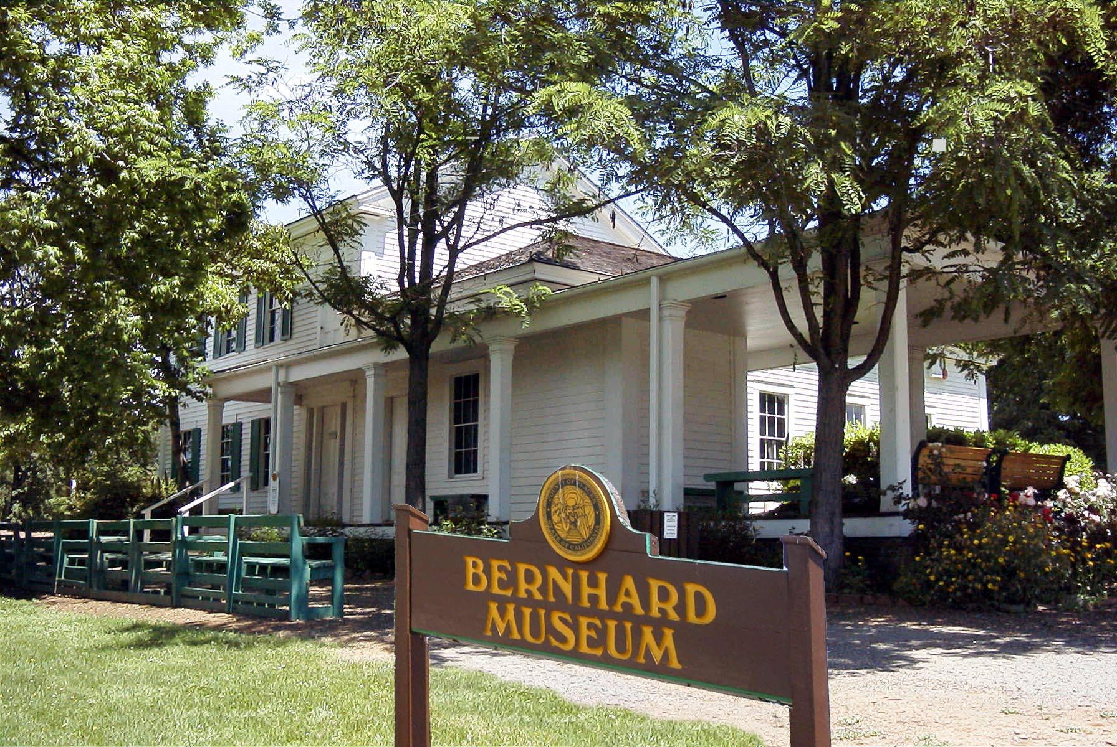
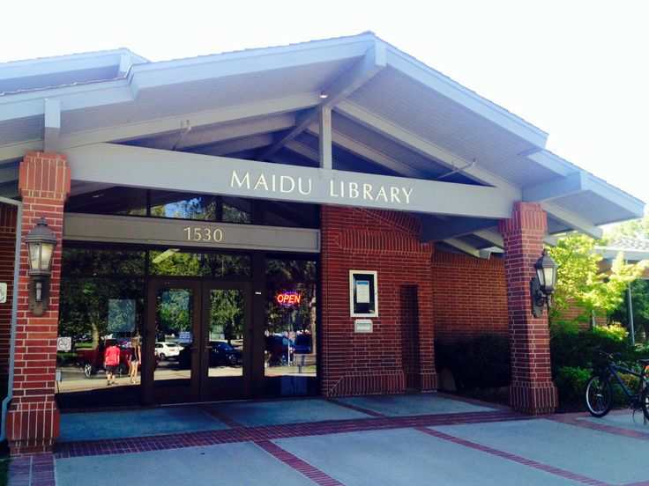
Field Trips
As a grade level team, we come to a decision as to which field trips we go on. Our decisions are based on on a myriad of reasons. We teachers appreciate you not questioning our decision making and value your understanding that the reasoning behind our decisions must remain confidential.
ALL parent volunteers must have fingerprinting and TB testing clearance PRIOR to chaperoning. Check with the office staff if you have questions.
Possible: Maidu Library (walking) TBD
Possible: Roseville Exploration Center TBD

Slide 14
We NEED You!
Please fill out form taped on cupboard in the back.

Slide 15
How Parents Can Help
Provide a nutritional breakfast, snack, water bottle, and lunch
Make sure your child gets enough sleep (nine to 12 hours)
Go over all their Friday Folder papers with them
Read to them and have them read to you at their level
Drill/Practice math facts nightly for 2 - 3 minutes
Telling time using an analog clock (elapsed time)
Practice counting money and making change as real life opportunities ar
Contact immediately if any sign of a problem or something is not understood
Read 30 minutes every day outside of school

Slide 16
THANK YOU!
Thank you for taking the time to be a part of your child’s education. I am excited to have your child this year and I look forward to working together to make this the best year possible for your child.

