Slide 1


Slide 2
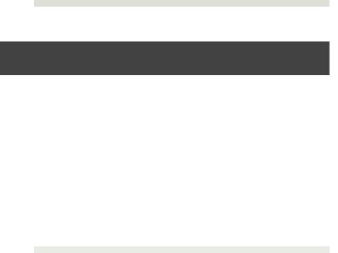
Meet the Staff and School Procedures

Slide 3
Drop Off
Kindergarteners and TK are waiting by the gates outside their classrooms.
First – Fifth Graders will enter the gate by the multi purpose room at 8:30. Bell rings at 8:35 to enter playground.
Yard duty will open the gate by Adventure Club at 8:30. If it is after that time and locked, use path by Adventure Club.
Front doors will be used for parents needing to check in at the office or students arriving late.

Slide 4
Parking Lot
Drive slowly
Please pull all the way forward when coming in to drop off or pick up
Do not leave car unattended

Slide 5
PTC President - Myndi White

Slide 6


Understanding California English Language Arts & Math Standards And How
Student Performance Is Reported
Notes:
Tonight I am going to share with you a general overview of how we are assessing and reporting the new California standards in Language Arts and Mathematics. A companion Parent Handbook will be shared with you and is specific to your child’s grade. I hope that you will refer to this handbook throughout the school year to better understand the grading and reporting process.

Slide 7
Three Big Ideas Tonight

Slide 8
What areas do we measure in
English Language Arts and Math*?
Mathematics Domains
Operations and Algebraic Thinking
Number and Operations in Base Ten
Numbers and Operations with Fractions
Measurement and Data
Geometry
English Language Arts Domains
Reading for Literature
Reading for Informational Text
Reading for Foundational Skills
Writing
Speaking and Listening
Language
*Third Grade Example
Notes:
Let’s take a look at the new California Math and Language Arts domains in this third grade example.
In grades K-5, domain areas remain fairly consistent with a few exceptions in some grade levels. For example, Counting and Cardinality is a Kindergarten domain that you would not see in third grade.
The term domain is a label for a group of standards. Not all domains are measured each trimester. Domain grades are reported at the end of each trimester (12 weeks of instruction)
Let’s take a look at one domain area to see the standards that make up this domain. For our example, we will select the domain highlighted in red under the English Language Arts section - Reading for Literature.
We will review what a third grader needs to cover for the domain of Reading for Literature for each trimester.

Slide 9
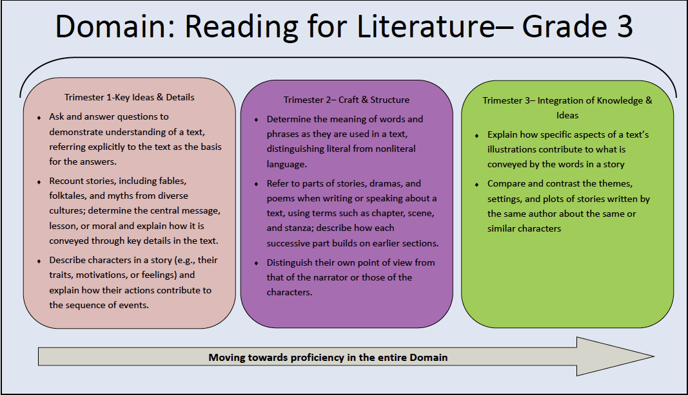
Notes:
Take a moment and look at what students are expected to do for each trimester. (read silently)
In our third grade example that there are eight standards under the Reading For Literature domain- three in trimester one, three in trimester two and two in trimester three.
Notice that each of the bullets lists different standards within the same domain that students are expected to be able to achieve. Standards listed in trimester 1 often take a full year of practice and development for students to attain success . You will see that the difficulty of the standards increases as you move from trimester one to trimester three. In order to demonstrate proficiency in a domain, students must master standards taught throughout the school year. It will take the entire school year for the teacher to cover and assess all of these standards. Within a domain, therefore, final grades are given in the last trimester.
Currently we are starting trimester one. If your child is in our third grade class, and they are successful in the three bulleted areas for trimester 1,he/she will be demonstrating that he/she is on Target (T) towards reaching proficiency by the end of the school year. We mark that on our report card as a “T”.

Slide 10
Key Ideas and Details – Trimester 1
Ask and answer questions to demonstrate understanding of a text, referring explicitly to the text as the basis for the answers.
Recount stories, including fables, folktales, and myths from diverse cultures; determine the central message, lesson, or moral and explain how it is conveyed through key details in the text.
Describe characters in a story (e.g., their traits, motivations, or feelings) and explain how their actions contribute to the sequence of events.

Slide 11
Craft and Structure – Trimester Two
Determine the meaning of words and phrases as they are used in a text, distinguishing literal from nonliteral language.
Refer to parts of stories, dramas, and poems when writing or speaking about a text, using terms such as chapter, scene, and stanza; describe how each successive part builds on earlier sections.
Distinguish their own point of view from that of the narrator or those of the characters.

Slide 12
Integration of Ideas and Knowledge – Trimester Three
Explain how specific aspects of a text’s illustrations contribute to what is conveyed by the words in a story (e.g., create mood, emphasize aspects of a character or setting).
Compare and contrast the themes, settings, and plots of stories written by the same author about the same or similar characters (e.g., in books from a series).

Slide 13
Notes:
Take a moment and look at what students are expected to do for each trimester. (read silently)
In our third grade example that there are eight standards under the Reading For Literature domain- three in trimester one, three in trimester two and two in trimester three.
Notice that each of the bullets lists different standards within the same domain that students are expected to be able to achieve. Standards listed in trimester 1 often take a full year of practice and development for students to attain success . You will see that the difficulty of the standards increases as you move from trimester one to trimester three. In order to demonstrate proficiency in a domain, students must master standards taught throughout the school year. It will take the entire school year for the teacher to cover and assess all of these standards. Within a domain, therefore, final grades are given in the last trimester.
Currently we are starting trimester one. If your child is in our third grade class, and they are successful in the three bulleted areas for trimester 1,he/she will be demonstrating that he/she is on Target (T) towards reaching proficiency by the end of the school year. We mark that on our report card as a “T”.

Slide 14
Trimester 1 and 2 grade options are as follows:

Slide 15


Mathematics Domains
Operations and Algebraic Thinking
Number and Operations in Base Ten
Numbers and Operations with Fractions
Measurement and Data
Geometry
English Language Arts Domains
Reading for Literature
Reading for Informational Text
Reading for Foundational Skills
Writing
Speaking and Listening
Language
We want your child to be scoring on Target or a “T” on the report card for both trimester one and trimester two in each of the reportable domains.
Notes:
So the first big idea we want you to take home tonight is that we want all of our students to be scoring on Target or a “T” on the report card in both trimesters 1 and 2. If they are doing this, your son and/or daughter is right where he/she needs to be. Students scoring a “T” are on pace towards receiving either a proficient or advanced score in trimester 3.
Remember by the end of the year, teachers will have measured all of the standards. It is only then that teachers will have enough evidence to give a final domain grade.

Slide 16
The final grade options are the following:
Advanced (A) | Student demonstrates advanced performance in this reportable area. Work is above the grade level standard.
Proficient (P) | Student demonstrates proficient performance in this reportable area. Work is at the grade level standard.
Basic (B) | Student demonstrates basic performance in this reportable area. Work is slightly below the grade level standard.
Limited (L) | Student demonstrates limited performance in this reportable area. Work is significantly below the grade level standard.
Notes:
At the end of the school year, teachers have taught all of the standards in each domain and have measured student progress. A final grade is ready to be prepared based on the scale you see here.
In our previous grading system, students who scored a “3” ranged quite a bit in their individual performance. Because the new standards offer opportunities for students to engage in learning English Language Arts and math concepts at a greater depth than ever before, we felt it was important to be able to recognize advanced understanding of a domain area.
The “Proficient” (P) level most closely represents the old “3” score on the report card. It is at this level that we expect all students to be performing at by the end of Trimester 3.
It is anticipated that a smaller percentage of students will score in the advanced category, but all students have the opportunity to reach the highest level of performance in our grading scale.

Slide 17


Mathematics Domains
Operations and Algebraic Thinking
Number and Operations in Base Ten
Numbers and Operations with Fractions
Measurement and Data
Geometry
English Language Arts Domains
Reading for Literature
Reading for Informational Text
Reading for Foundational Skills
Writing
Speaking and Listening
Language
We want your child to be scoring Proficient or a “P” by the end of the year in each of the reportable domains.
Notes:
Big Idea #2 is that if your child is scoring proficient by the end of the school year in any domain he/she is doing very well. The standards in these domain areas are more rigorous than anything we have expected in the past from our students in California. Without question, proficient students are ready for success in the next grade level.

Slide 18
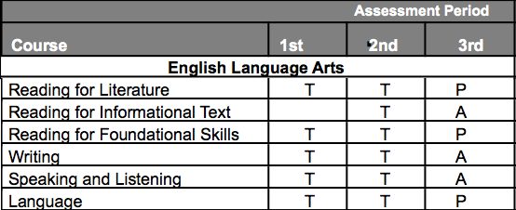
End of Year Scores
B
L
L
B
Notes:
Lets take a look at what a report card may look like by the end of the school year. Your parent handbook will provide a detailed explanation of the scoring system for trimester 1, 2, & 3. This student was slightly behind our benchmark targets at the end of the first trimester in Reading for Literature scoring a “Basic” or “B”, but was back on target in the second trimester and scored proficient by the end of the year. In all other areas, this student hit the target expectations and performed accordingly in the final, end-of-year, trimester 3 grades .
You will also notice that there are not grades in every cell. If a cell is blank, it is not an area we report on for that trimester.

Slide 19
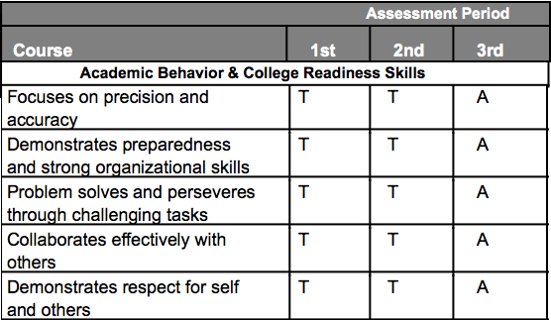
College and Career Readiness Standards
B
P
B
P
P
Notes:
Also on the report card a series of 5 College and Career Readiness standards. These are skills that are indicative of future success in middle school, high school, college and careers.
Descriptions of these standards can be found in your Parent Handbook as well.

Slide 20

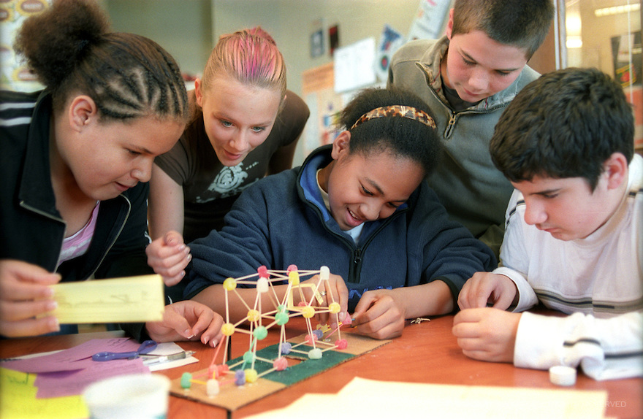

Academic Behavior and College Readiness Skills (ABC) are developmentally very different in kindergarten than in fifth grade. Our goal is to get all students ready to be successful in these five ABC standards prior to entering middle school.
Notes:
Please take a moment to read Big idea #3.
Our goal is to prepare your child to have all the content and college and career readiness skills that a 5th grader needs to be successful moving into middle school. To do that we set performance expectations from kindergarten through 5th grade that grow as the students mature.

Slide 21
District Reading & Writing Assessments
Grade | Performance Measure | Trimester 1 | Trimester 2 | Trimester 3 | Trimester 3 Goal Score
3 | Writing Prompt | Informational | Narrative | Argumentative/Opinion | 3 or above
Grade | Performance Measure | Trimester 1 Benchmark | Trimester 2 Benchmark | Trimester 3 Benchmark
3 | STAR Reading | Scale Score > than 345+ | Scale Score > than 374+ | Scale Score > than 409+
3 | ELA Performance Task | x | x | 3 or above
Notes:
District Assessments
District wide, writing assessments are administered each trimester. Each writing score is utilized to help determine individual and district wide writing performance. District writing scores are graded on a 4 point scale. The goal for all third students is to score a 3 or above by the end of the year.
In addition, each trimester, your child will take a computer-adaptive reading test and you will receive a parent reading progress report. The score reported on the report card is the Scaled Score (SS). The Scaled Score measures the difficulty level of the questions and the number of correct responses.
Lastly, at the end of the school year, your child will take a performance assessment in ELA. The performance assessment will measure reading, writing, and language in an integrated manner. Students will complete activities throughout the year that will prepare them for this performance task.

Slide 22
District Math Assessments
Grade | Performance Measure | Trimester 1 Benchmark | Trimester 2 Benchmark | Trimester 3 Benchmark
3 | STAR Math | Scale Score > than 528+ | Scale Score > than 566+ | Scale Score > than 603+
3 | Performance Assessments | 3 or above | 3 or above | 3 or above
Notes:
District Assessments
Like English Language Arts, each trimester your child will take a computer-adaptive mathematics test and you will receive a parent progress report. The score reported on the report card is the Scaled Score (SS).
Students also take performance assessments each trimester in mathematics. These assessments are scored on a four point scale. Students scoring at a 3 or above are meeting the trimester benchmark target.

Slide 23
What are the Big Ideas?
1. “T” or on target for trimester 1 and 2.
2. “P” or proficient at end of the year.
3. Our goal is to get all students ready to be successful in the Academic Behavior and College Readiness Skills by end of 5th grade.

Slide 24
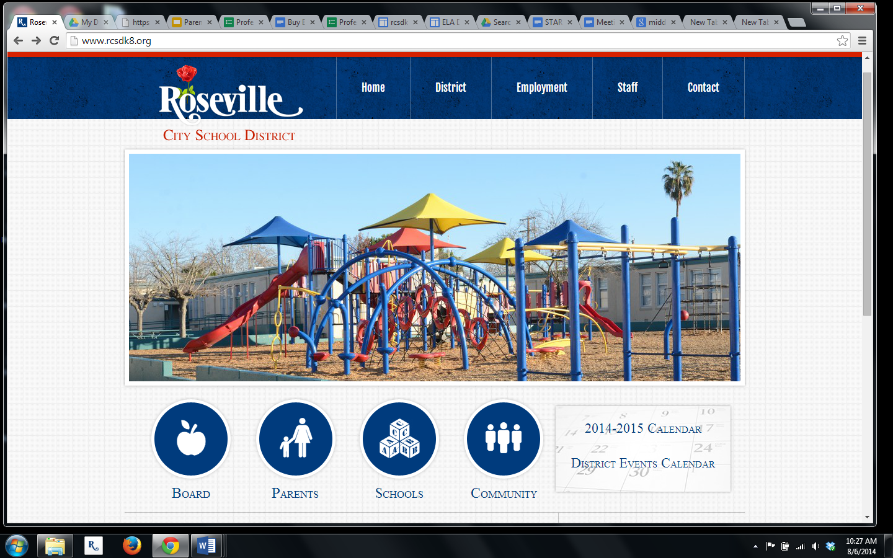
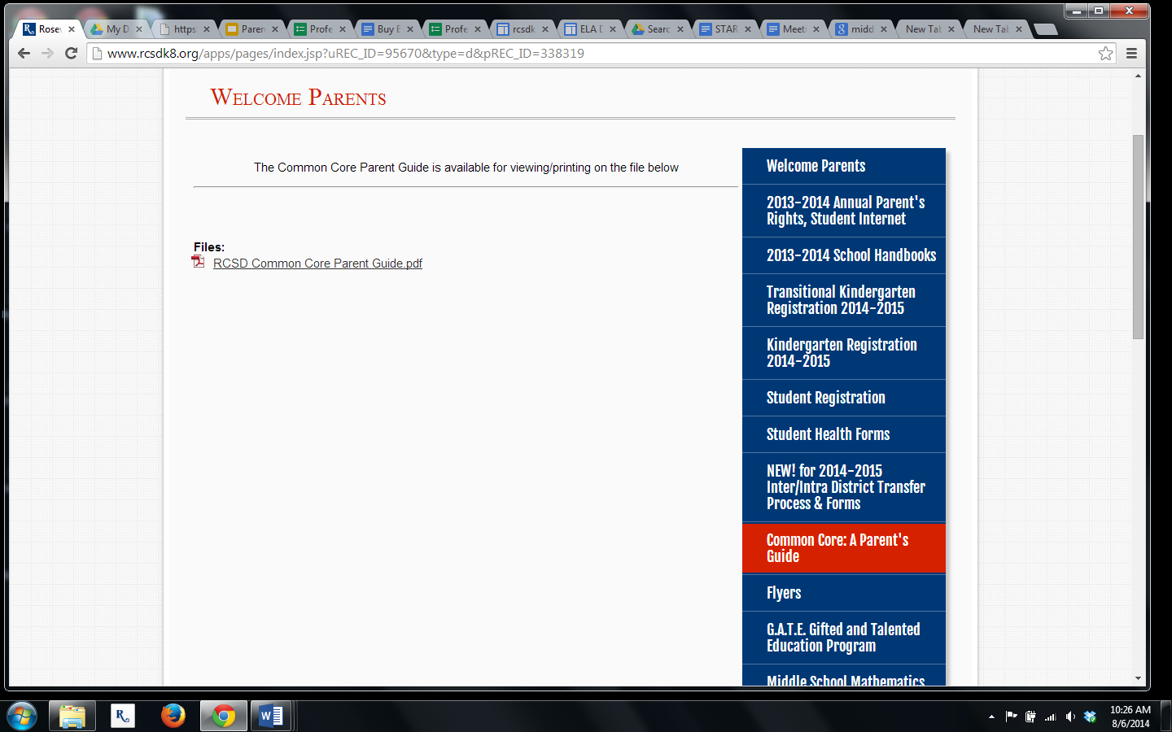
Where can you find the Parent Handbook?
District Website, Parents Tab, and Common Core: A Parent’s Guide Section
http://www.rcsdk8.org/apps/pages/index.jsp?uREC_ID=95670&type=d&pREC_ID=176650
Notes:
You can find the electronic version of the parent handbook on the District website under the Parent’s tab and Common Core: A Parent’s Guide Section.
In this section, you can also view STAR Reading and Mathematics Benchmark Performance Tables for all grades Kindergarten through 8th grade.

Slide 25
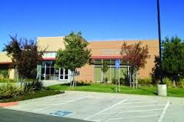
Additional Information
Parent Information Nights- RCSD Grading and Assessing
Roseville City School District Board Room - 1050 Main Street
September 17, 2014
September 24, 2014
6:30 p.m. - 7:30 p.m.
Notes:
If you have someone in your family that missed this session or you would like to know more about the new standards and how they are graded and assessed, we are holding two District wide parent information nights on September 17th and 24th in our Board Room from 6:30 - 7:30 p.m.

Slide 26

Notes:
That concludes our presentation.
Are there any questions I can answer?

Slide 27

Thank you!
Classroom Presentations 6:40-7:10 and 7:15-7:45

